Slide 1
Analyzing algorithms
& Asymptotic Notation
BIO/CS 471 – Algorithms for Bioinformatics

Slide 2
Why Sorting Algorithms?
Simple framework
Sorting & searching
  Without sorting, search is random
Finding information
  Sequence search
  Similarity identification
  Data structures & organization

Slide 3
Sorting algorithms
SelectionSort
  Looking at a “slot” = 1 operation
  Moving a value = 1 operation
  n items = (n+1)(n) operations
  n items = 2n memory positions
7
2
9
4
6

Slide 4
The RAM model of computing
Linear, random access memory
READ/WRITE = one operation
Simple mathematical operations
are also unit operations
Can only read one location at
a time, by address
Registers
0000
0001
0002
0003
0004
0005
0006
0007
0008
0009
0010
…

Slide 5
“Naïve” Bubble Sort
Simplifying assumption: compare/swap = 1 operation
Each pass = (n-1) compare/swaps
n passes = (n)(n-1) compare/swaps
Space = n
7
2
9
4
6

Slide 6
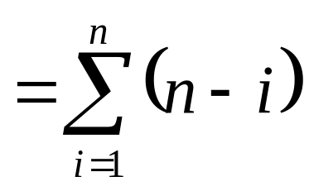
“Smart” Bubble Sort
MikeSort:
First pass (n-1) compare/swaps
Next pass (n-2) compare/swaps
n inputs: (n-1) + (n-2) + (n-3) … + 1
  We need a mathematical tool to solve this.
7
2
9
4
6

Slide 7
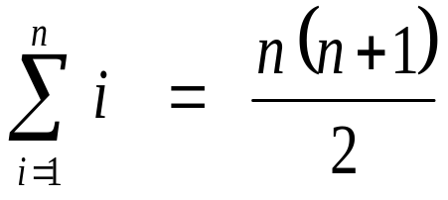
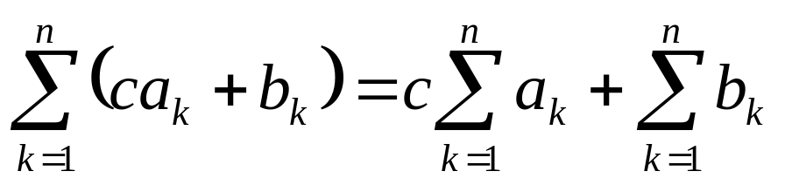
Series Sums
The arithmetic series:
  1 + 2 + 3 + … + n =
Linearity:

Slide 8
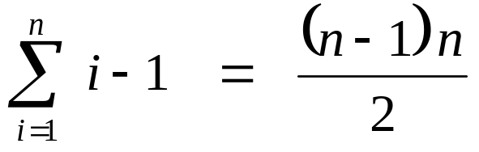
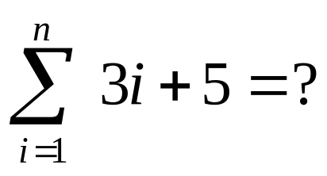
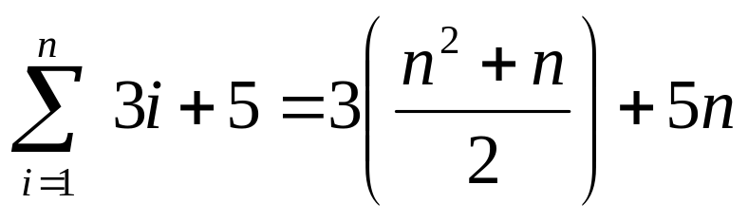
Series Sums
0 + 1 + 2 + … + n – 1 =
Example:

Slide 9
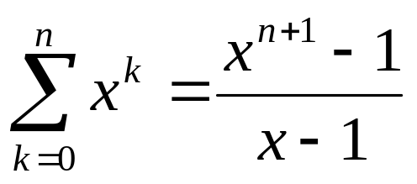
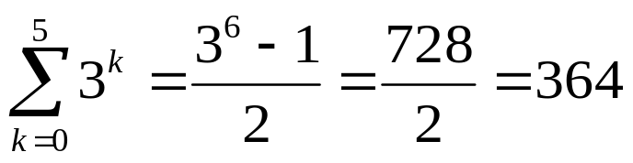
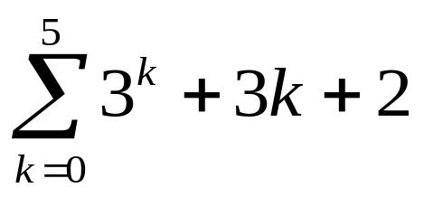
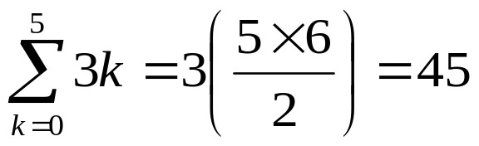
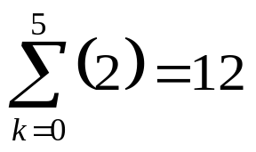

More Series
Geometric Series: 1 + x + x² + x³ + … + x^{n}
Example:

Slide 10
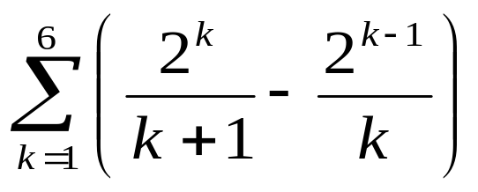
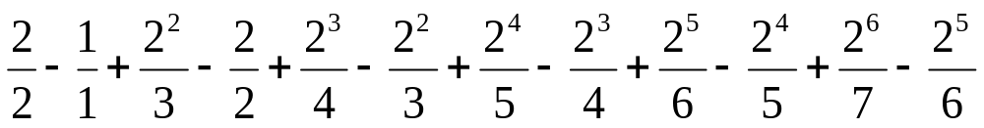
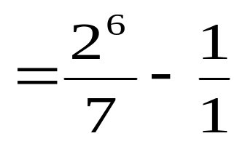
Telescoping Series
Consider the series:
Look at the terms:

Slide 11
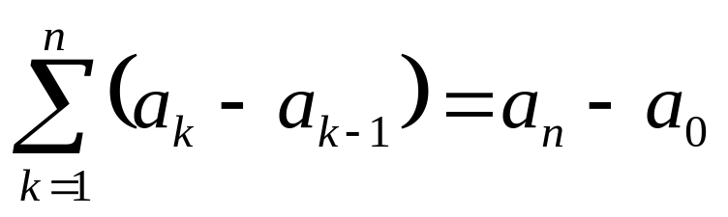
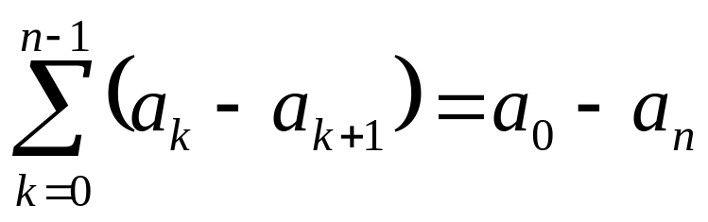
Telescoping Series
In general:

Slide 12
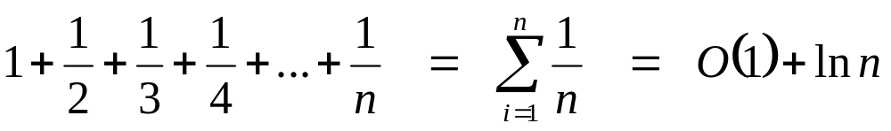
The Harmonic Series

Slide 13
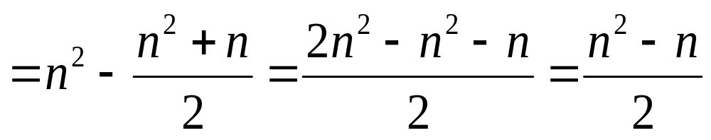
Time Complexity of MikeSort
“Smart” BubbleSort
n inputs: (n-1) + (n-2) + (n-3) … + 1
7
2
9
4
6

Slide 14
Exact Analysis of Algorithms
To make it easy, we’ll ignore loop control structures, and worry about the code in the loops.
Each line of code will be considered one “operation”.
for ($i=1; $i<=$n; $i++) {
print $i;
}
for ($i=1; $i<=$n; $i++) {
print $i;
print “Hi there\n”.
}

Slide 15
Exact analysis
for ($i=1; $i<=$n; $i++) {
for ($j=1; $j<=$n; $j++) {
print “$i, $j\n”;
}
$i = 1
  $j =1 , 2, 3, … n
$i = 2
  $j = 1, 2, 3, … n etc.
Total: n² operations

Slide 16
Exact Analysis of BubbleSort
# $i is the pass number
for ($i=0; $i<$n-1; $i++) {
# $j is the current element looked at
for ($j=0; $j<$n-1; $j++) {
if ($array[$j] > $array[$j+1]) {
swap($array[$j], $array[$j+1]);
}
}
}
What if the array is often already sorted or nearly sorted??
Best case: n²
Worst case: 2n²
Average case: 1.5(n²)

Slide 17
Exact Analysis of MikeSort
# $i is the pass number
for ($i=1; $i<=$n-1; $i++) {
# $j is the current element looked at
for ($j=1; $j<=$n-$i; $j++) {
if ($array[$j] > $array[$j+1]) {
swap($array[$j], $array[$j+1]);
}
}
}
Best case: = (n² – n)/2
Worst case: n² – n
Average case: 1.5((n² – n)/2) = (3n² – 3n)/2

Slide 18
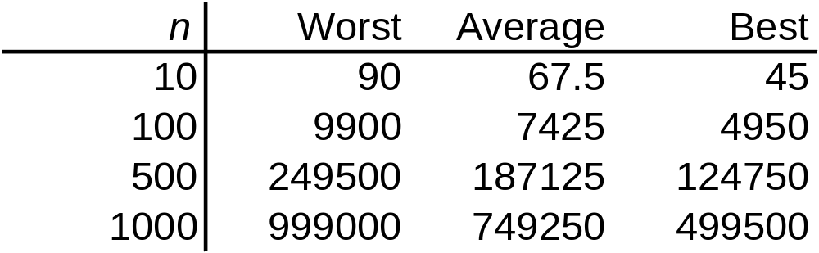
Exact Analysis of MikeSort
Best case: = (n² – n)/2
Worst case: n² – n
Average case: 1.5((n² – n)/2) = (3n² – 3n)/2

Slide 19
Traveling Salesman Problem
n cities
  Traveling distance between each pair is given
  Find the circuit that includes all cities
25
E
15
22
12
F
21
A
35
8
10
D
B
23
20
22
19
19
14
25
G
C
33

Slide 20
Is there a “real difference”?
10^1
10^2
10^3 Number of students in the college of engineering
10^4 Number of students enrolled at Wright State University
10^6 Number of people in Dayton
10^8 Number of people in Ohio
10^10 Number of stars in the galaxy
10^20 Total number of all stars in the universe
10^80 Total number of particles in the universe
10^100 << Number of possible solutions to traveling salesman (100)
Traveling salesman (100) is computable but it is NOT feasible.

Slide 21
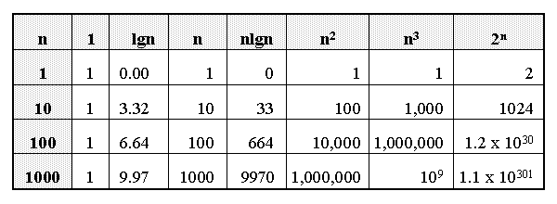
Growth of Functions

Slide 22
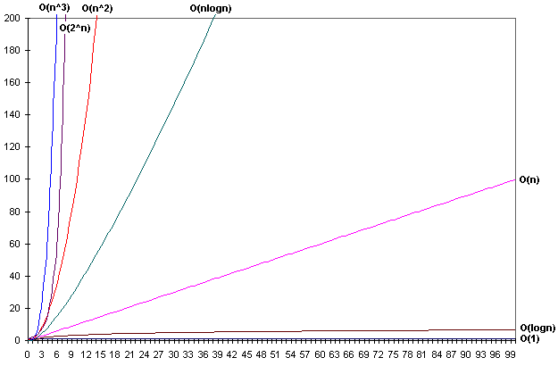
Is there a “real” difference?
Growth of functions

Slide 23
Introduction to Asymptotic Notation
We want to express the concept of “about”, but in a mathematically rigorous way
Limits are useful in proofs and performance analyses
Talk about input size: sequence align
Θ notation: Θ(n²) = “this function grows similarly to n²”.
Big-O notation: O (n²) = “this function grows at least as slowly as n²”.
  Describes an upper bound.

Slide 24
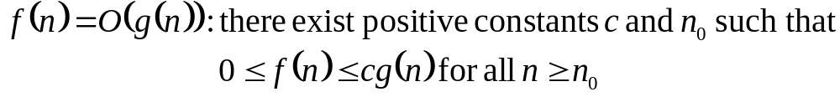
Big-O
What does it mean?
  If f(n) = O(n²), then:
    f(n) can be larger than n² sometimes, but…
    I can choose some constant c and some value n₀ such that for every value of n larger than n₀ : f(n) < cn²
    That is, for values larger than n₀, f(n) is never more than a constant multiplier greater than n²
    Or, in other words, f(n) does not grow more than a constant factor faster than n².

Slide 25
Visualization of O(g(n))
cg(n)
f(n)
n₀

Slide 26
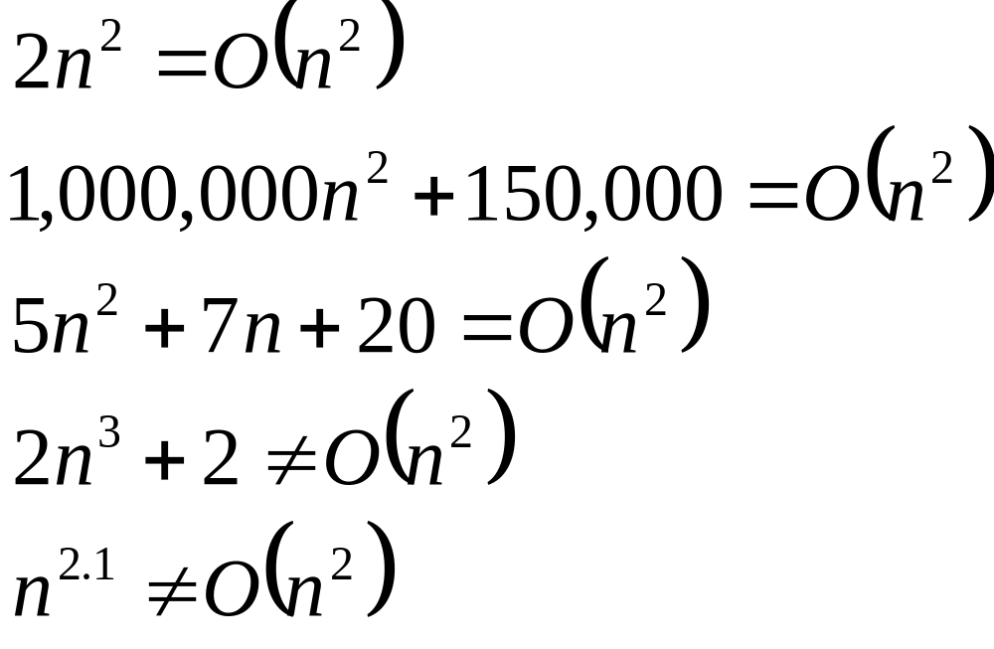
Big-O

Slide 27
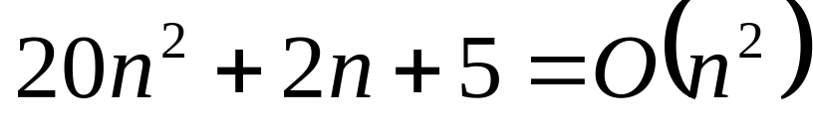
More Big-O
Prove that:
Let c = 21 and n₀ = 4
21n² > 20n² + 2n + 5 for all n > 4
n² > 2n + 5 for all n > 4
TRUE

Slide 28
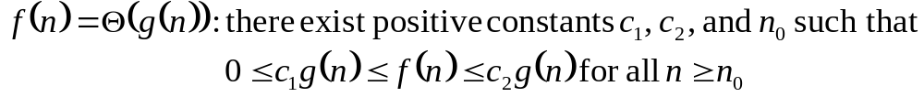
Θ-notation
Big-O is not a tight upper bound. In other words n = O(n²)
Θ provides a tight bound

Slide 29
Visualization of Θ(g(n))
c₂g(n)
f(n)
c₁g(n)
n₀

Slide 30
A Few More Examples
n = O(n²) ≠ Θ(n²)
200n² = O(n²) = Θ(n²)
n^{2.5} ≠ O(n²) ≠ Θ(n²)

Slide 31
Some Other Asymptotic Functions
Little o – A non-tight asymptotic upper bound
  n = o(n²), n = O(n²)
  3n² ≠ o(n²), 3n² = O(n²)
Ω() – A lower bound
  Similar definition to Big-O
  n² = Ω(n)
ω() – A non-tight asymptotic lower bound
f(n) = Θ(n) ⇔ f(n) = O(n) and f(n) = Ω(n)

Slide 32
Visualization of Asymptotic Growth
o(f(n))
O(f(n))
Θ(f(n))
f(n)
Ω(f(n))
ω(f(n))
n₀

Slide 33
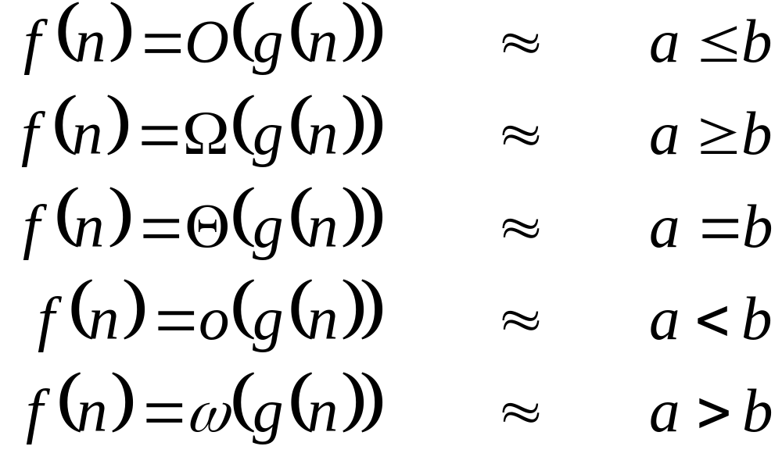
Analogy to Arithmetic Operators

Slide 34
Approaches to Solving Problems
Direct/iterative
  SelectionSort
  Can by analyzed using series sums
Divide and Conquer
  Recursion and Dynamic Programming
  Cut the problem in half
  MergeSort

Slide 35
Recursion
Computing factorials
fib(5)
sub fact($n) {
if ($n <= 1) {
return(1);
}
else {
$temp = $fact($n-1);
$result = $temp + 1;
return($result);
}
}
print(fact(4) . “\n”);

Slide 36
Fibonacci Numbers
int fib(int N) {
int prev, pprev;
if (N == 1) {
return 0;
}
else if (N == 2) {
return 1;
}
else {
prev = fib(N-1);
pprev = fib(N-2);
return prev + pprev;
}
}

Slide 37
MergeSort
7
2
9
4
6
9
4
6
Let M_{n} be the time to MergeSort n items
  M_{n} = 2(M_{n-1}) + n

